Slide 1
50 kW Integrated Fault Tolerant Permanent Magnet Machine and Motor Drive

Slide 2
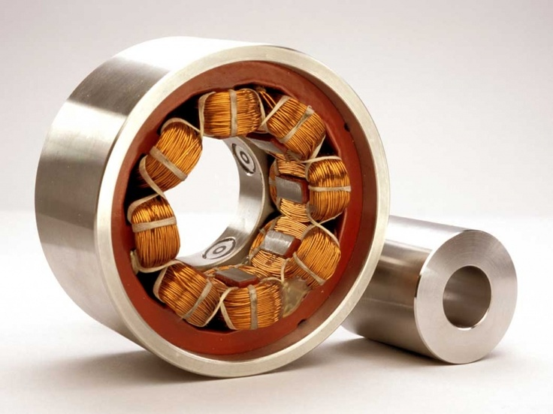

Slide 3
Overwiev
Machine and Power electronics losses and PSFB (Phase Shifted Full Bridge) concept
Thermal Design

Slide 4
Benefits of system integration (adding power electronic to machine)
-Power density can be increased.
-total weight and volume is intended to decrease. (at Aerospace and electric car etc. It is important)

Slide 5
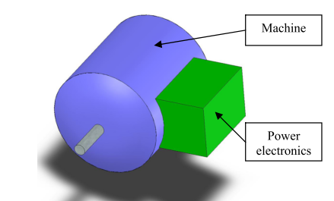

Slide 6
Problem
If loss density remains same, there will be heating

Slide 7
The objective of this paper is to investigate the feasibility of integrating a fault tolerant system consisting of an electrical machine and power electronics into a single, more power dense structure.

Slide 8
Fault Tolerace and System Integration
Redundancy
Partitioning

Slide 9
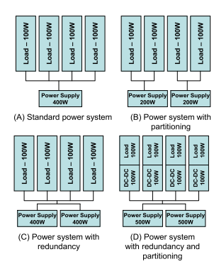

Slide 10
Permanent Magnet is preferred for higher power density but switched reluctance machine also preferred for fault tolerant applications.

Slide 11
Phase number should be adjusted by optimizing loss and healthy phases.

Slide 12
Machine Design and Construction
Isolated and concentrated structure
Balance

Slide 13
In order to prevent short circuit phases should be isolated magnetically and electrically from neighbours.
If there is a fault condition, not one, two phase should be removed to satisfy balance.

Slide 14
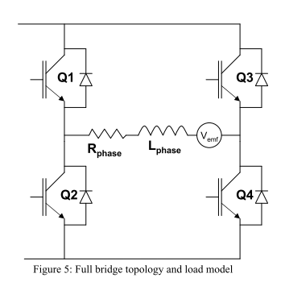
Power Electronics

Slide 15
PSFB (Phase Shifted Full Bridge):
There is low frequency an it limits semiconductor losses to induction loss only.
• If fault condition occurs in the DC bus capacitors, bus capacitors will be disonnected via the fuse.

Slide 16
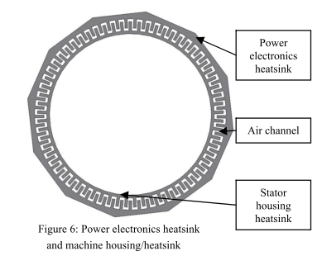
Thermal Management and Packaging Concept

Slide 17
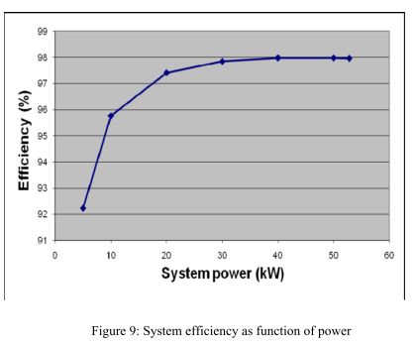

Slide 18
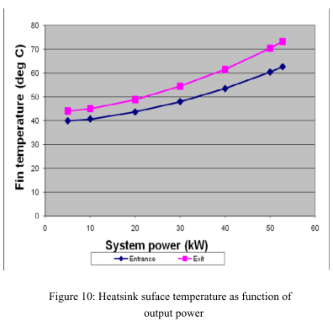

Slide 19
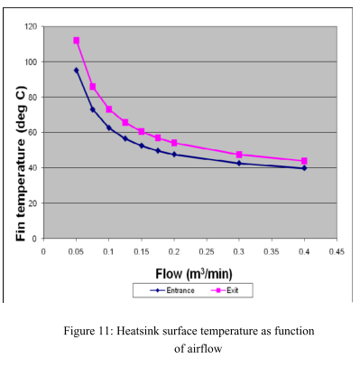

Slide 20
SUMMARY
Intention:
Significant decrease at total volume while keeping total output the same.

Slide 21
Switched Reluctance Machines
Copper fill fator is high
However, SRM needs two terminal conections per phase

Slide 22
Design of Intagrated and Distributed Inverter
Inverters consist of one asymmetrical half bridge per phase, two switches and two diodes
There are redundancy (if there is failure, remaining phases can continue the operation.)

Slide 23
Loss is low and cooling performance is great
However, integrated inverters are expensive comparing to standard inverter.

Slide 24
Communication
Phase connected parallel and communication is satisfied via DSP.

Slide 25
Implemented Torque Control
Using feedback loop torque and flux linkage are modeled at MATLAB or SIMULING.
Torque and flux linkage depend on current and rotor position.
Torque ripple is observed for varying speeds.

Slide 26
Fault Tolerance Analysis
Average Torque and Torque Ripple:
Whithout any fault compensation or feedback loop torque is reduced proportionally the number of fault phase

Slide 27
Vibration Shape:
Also, vibration shape is observed at fault condition. It is proposed that, the simplest way to reduce vibration is turn off the module opposite the faulty module.

Slide 28
Summary
Inverters allows much number of phase without increase the number of terminals. It satisfies redundancy.
To satisfy torque optimization, FEM is used and machine characteristic is analyzed. Ripple on the torque is tried to decrease (below 10%)

Slide 29
Balance is crucial. If one phase module is faulted, vibration increase because of asymetric excitation and magnetic pull. Opposite phase module can be removed to satisfy symmetry.

